Slide 1
Capstone Engagement
Assessment, Analysis, and Hardening of a Vulnerable System By: Ben Wong

Slide 2
Table of Contents
This document contains the following sections:
01
Network Topology
02
Red Team: Security Assessment
03
Blue Team: Log Analysis and Attack Characterization
Hardening: Proposed Alarms and Mitigation Strategies
04

Slide 3
Network Topology
3

Slide 4
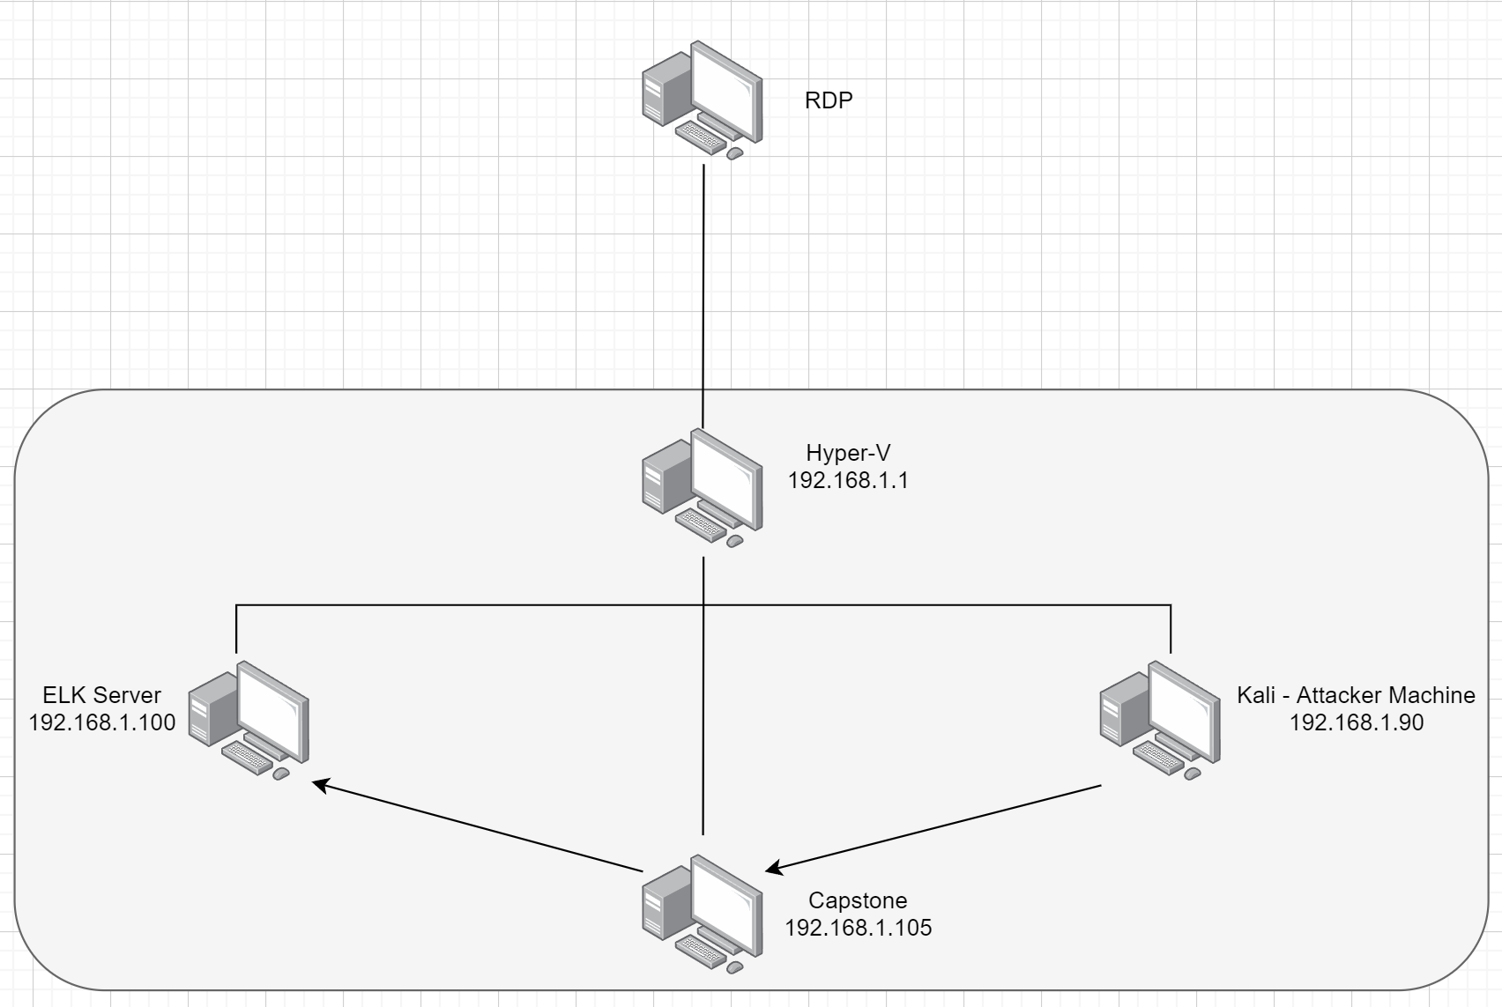
Network Topology
Network
Address Range: 10.0.0.0/20
Netmask: 255.255.240.0
Gateway: 10.0.0.1
Machines
IPv4: 192.168.1.1
OS: Windows
Hostname: Hyper-V
IPv4: 192.168.1.90
OS: Kali Linux
Hostname: Kali
IPv4: 192.168.1.105
OS: Ubuntu
Hostname: Capstone
IPv4: 192.168.1.100
OS: Ubuntu
Hostname: ELK

Slide 5

Red Team
Security Assessment
5

Slide 6
Recon: Describing the Target
Nmap identified the following hosts on the network:
Hostname | IP Address | Role on Network
Hyper-V | 192.168.1.1 | Hypervisor
ELK | 192.168.1.100 | SIEM for Capstone
Capstone | 192.168.1.105 | Vulnerable target web server
Kali | 192.168.1.90 | Attacker machine

Slide 7
Vulnerability Assessment
The assessment uncovered the following critical vulnerabilities in the target:
Vulnerability | Description | Impact
Open http port vulnerability | An attacker with network access to the web server on port 80/TCP could execute system commands with administrative privileges without any user interaction | Was able to locate sensitive information in /company_folders/secret_folder/. Also discovered that Ashton is the administrator for the directory /company_folders/secret_folder/
Password brute force vulnerability (OWASP top 10: 2021-Identification and Authentication Failures) | Weak password found in dictionary “rockyou”. Also no lockout feature for multiple failed login attempts | Brute force revealed password to /company_folders/secret_folder/
Persistent reverse shell backdoor vulnerability | Able to deploy a reverse shell payload exploit on the web server since defences allow outbound ports traffic | Gained remote backdoor shell access to the Capstone web server

Slide 8
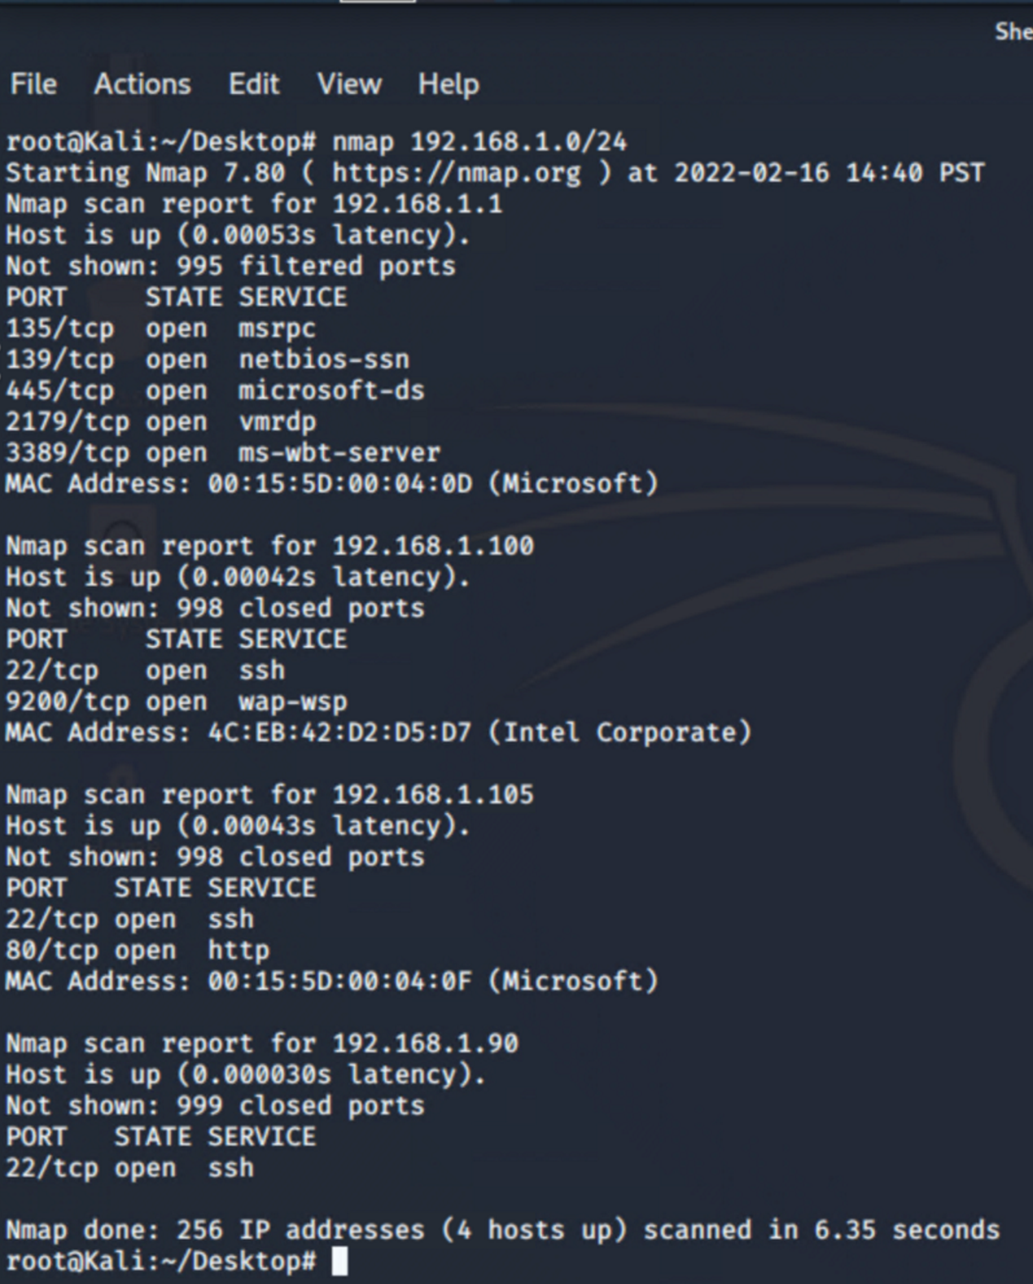
Exploitation: Open http port vulnerability
01
02
03
Tools & Processes
Used nmap to scan for ports
Command:
Nmap 192.168.1.0/24
Achievements
Discovered that port 22 and port 80 were open on the victim machine

Slide 9
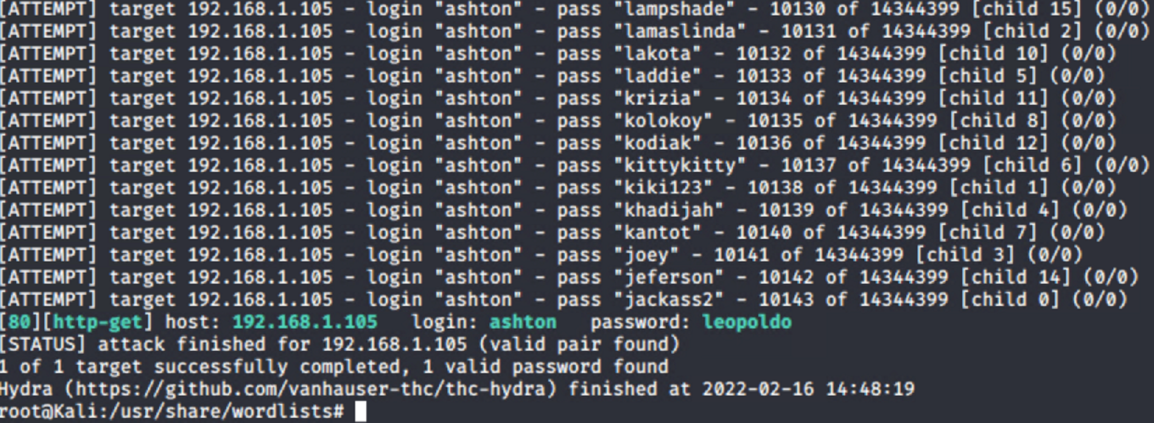
Exploitation: Password brute force vulnerability
Tools & Processes
Used hydra with the rockyou wordlist to brute force the user Ashton’s password
01
Command:
hydra -l ashton -P rockyou.txt -s 80 -f -vV 192.168.1.105 http-get /company_folders/secret_folder
02
03

Slide 10
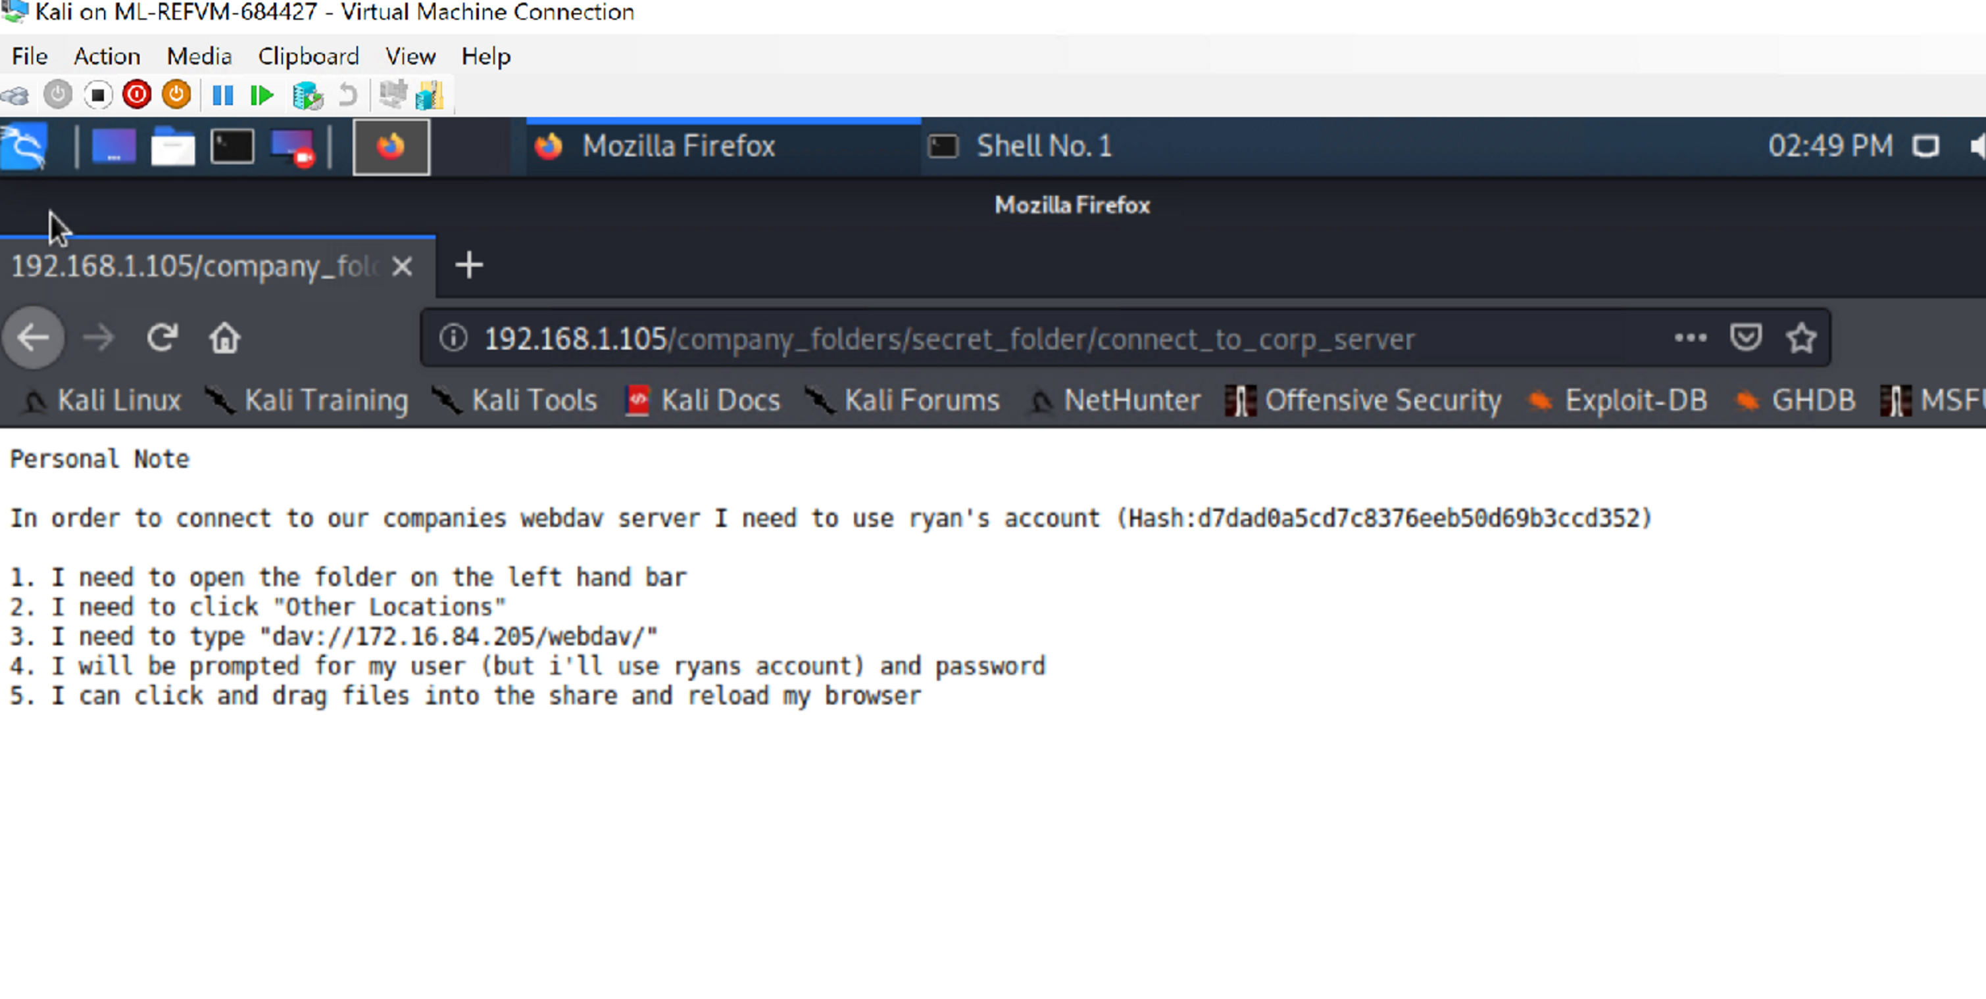
Exploitation: Password brute force vulnerability (continued)
Accessing /192.168.1.105/company_folders/secret_folder/
1. Discovered instructions on how to access webdav in /secret_folder/ using Ashton’s credentials

Slide 11
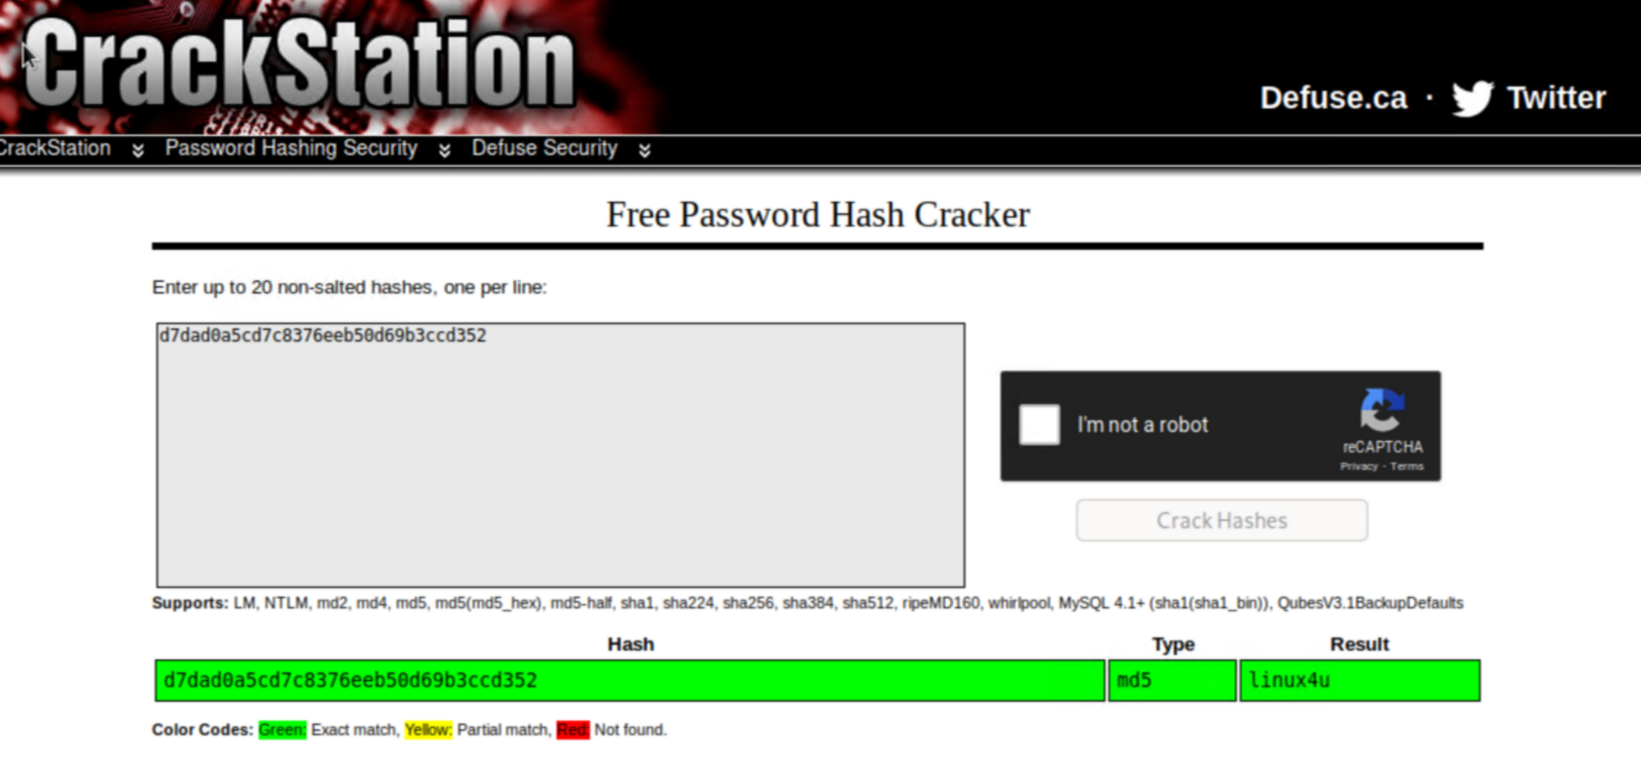
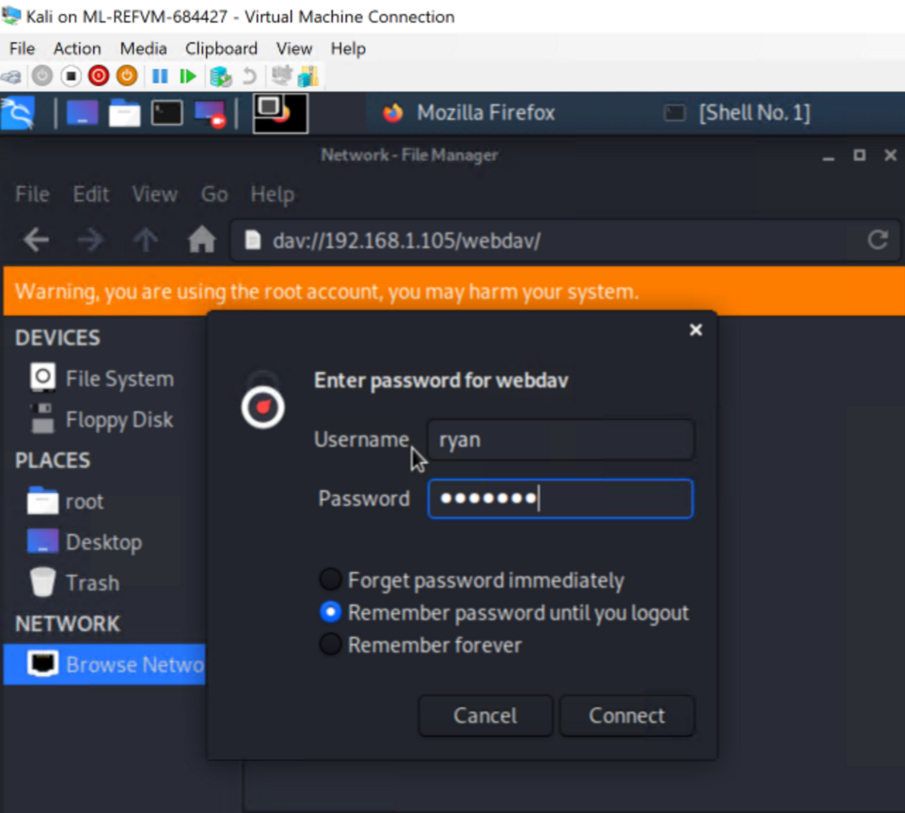
Exploitation: Cracking the Hash
Accessing webdav
Used CrackStation to crack the hash provided in /secret_folder/
Used the cracked hash as password for Ryan’s webdav account

Slide 12
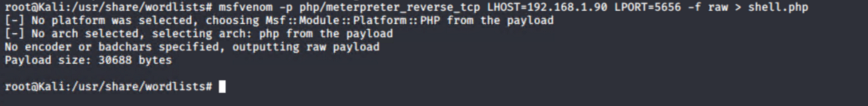
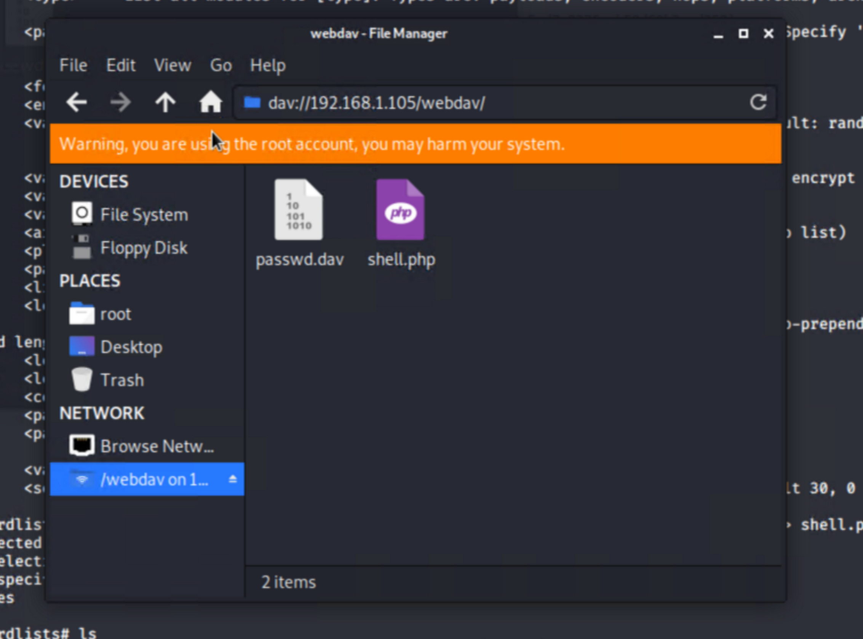
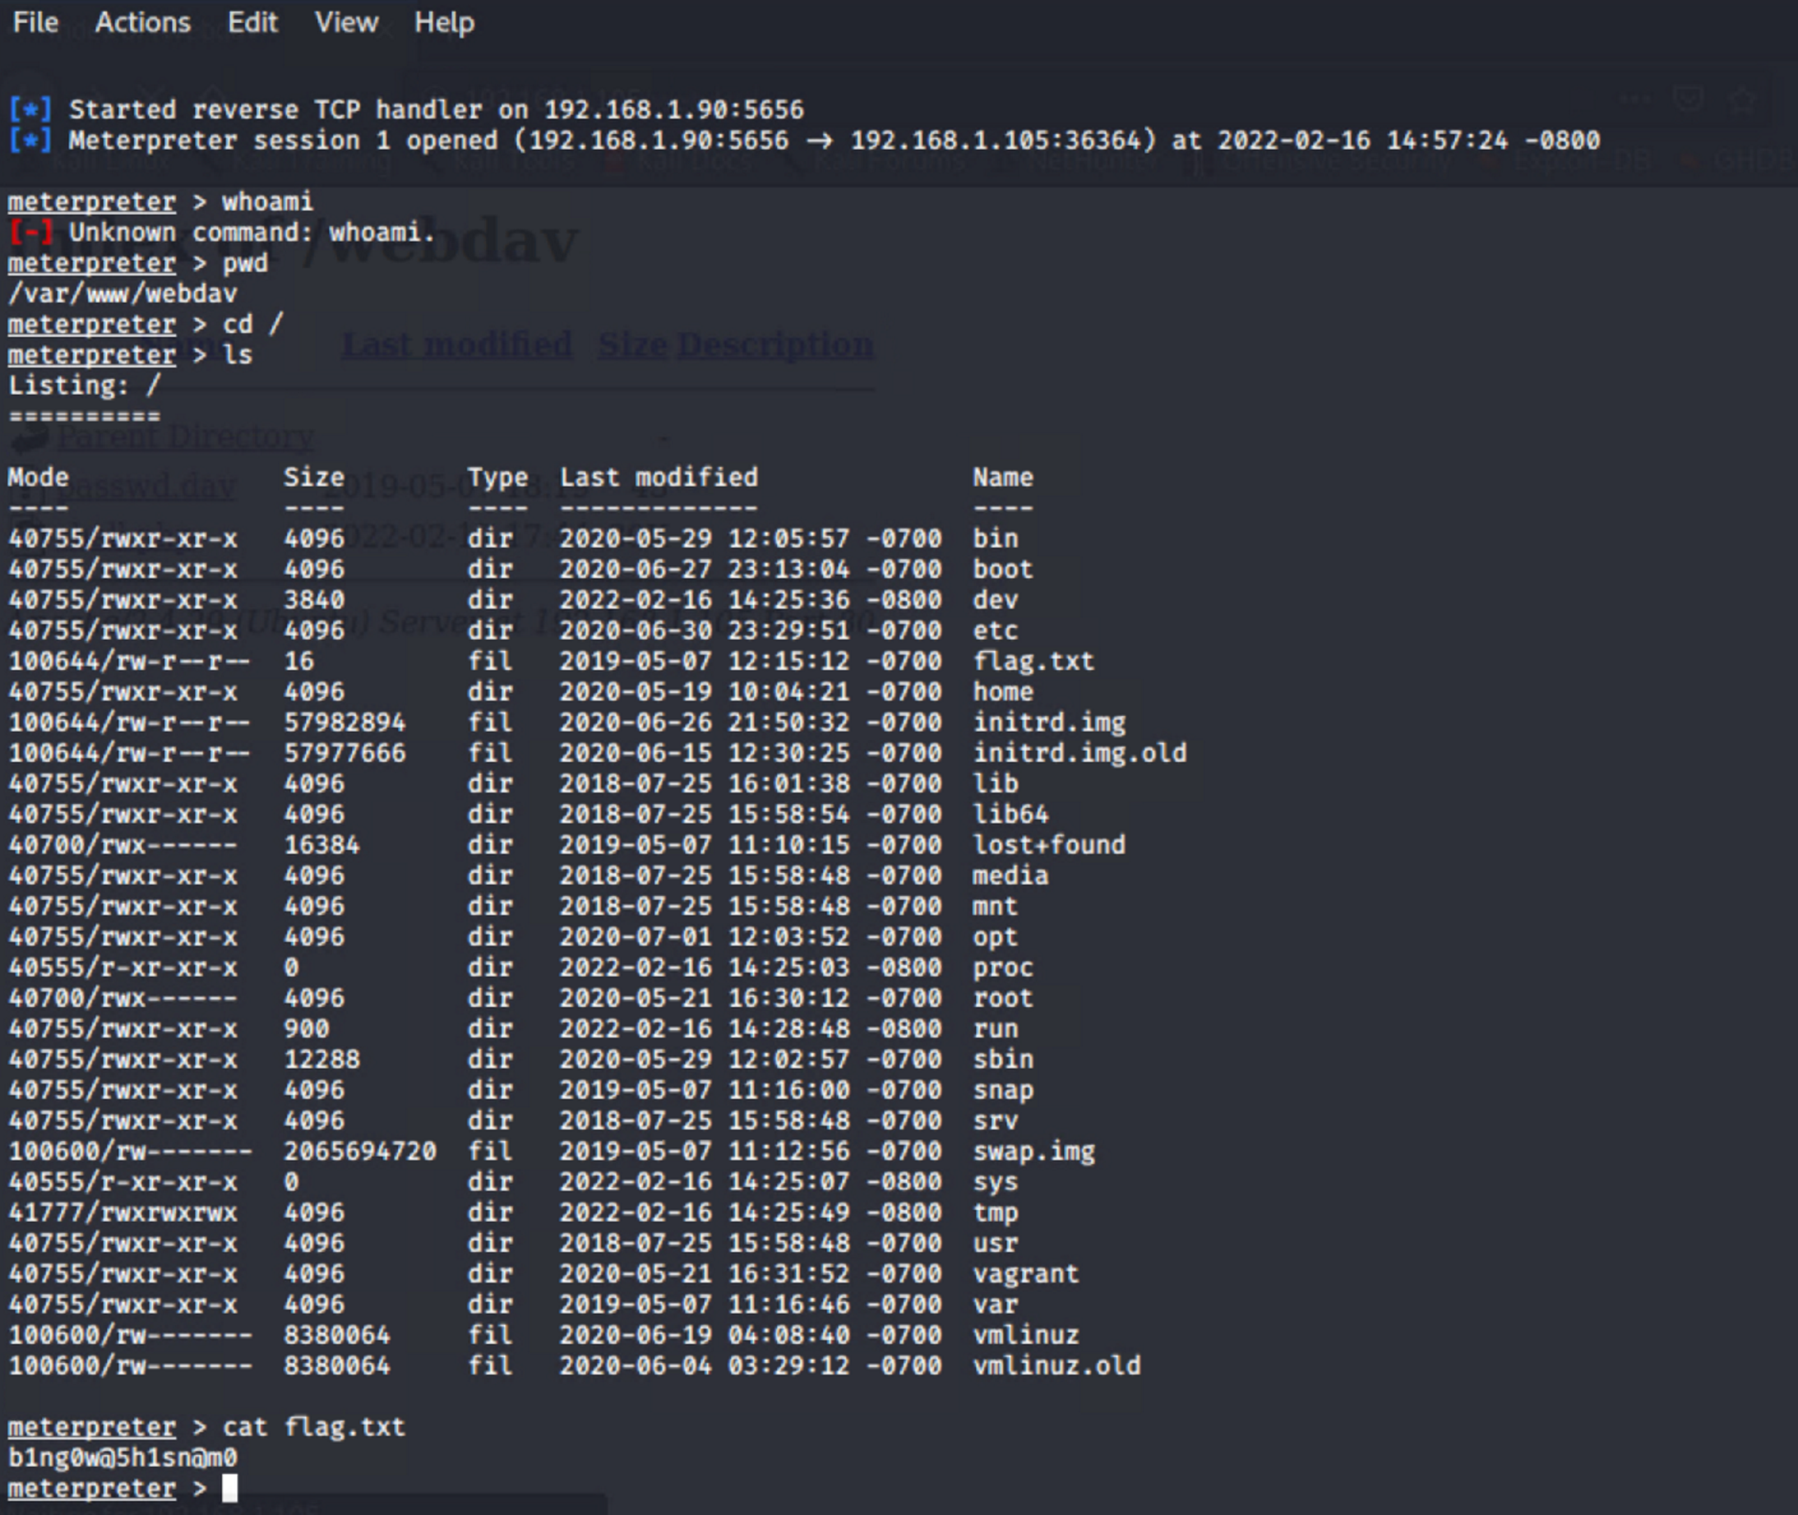
Exploitation: Persistent reverse shell backdoor
01
Tools & Processes
1. Created a payload with msfvenom
2. Upload payload to webdav server using credentials found in /secret_folder/
3. Used meterpreter to create a remote listener and spawn a reverse shell on the Capstone server
1.
2.
02
Achievements
Gained access to the root directory on the 192.168.1.105 server
3.

Slide 13

Blue Team
Log Analysis and Attack Characterization
13

Slide 14
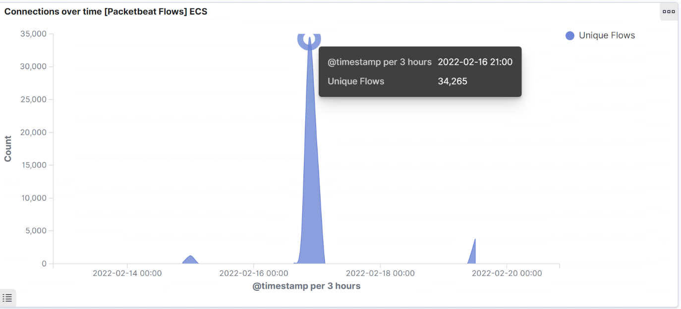
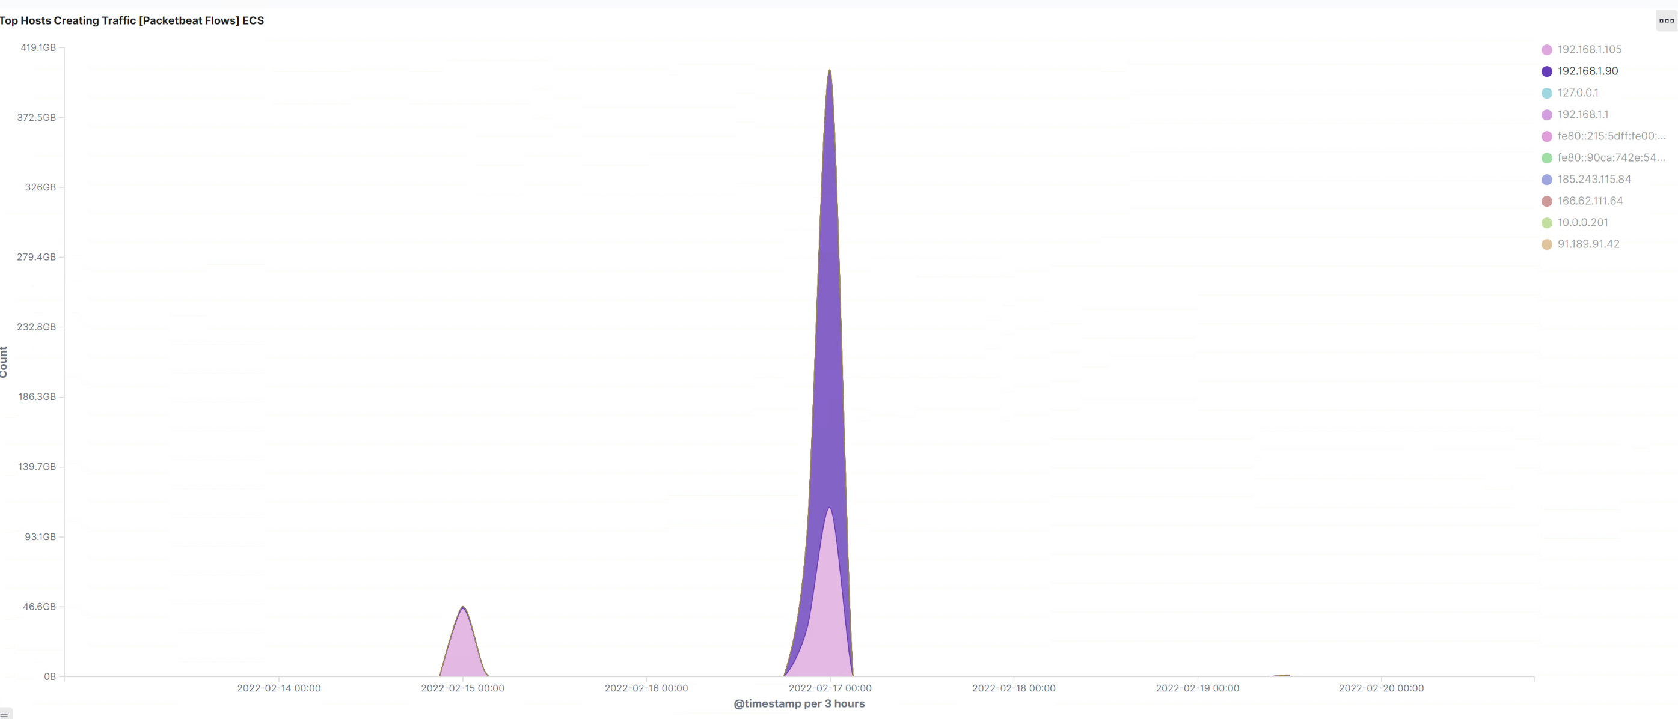
Analysis: Identifying the Port Scan
What time did the port scan occur? | 21:00
How many packets were sent, and from which IP? | 34,265 packets were sent, from 192.168.1.90

Slide 15
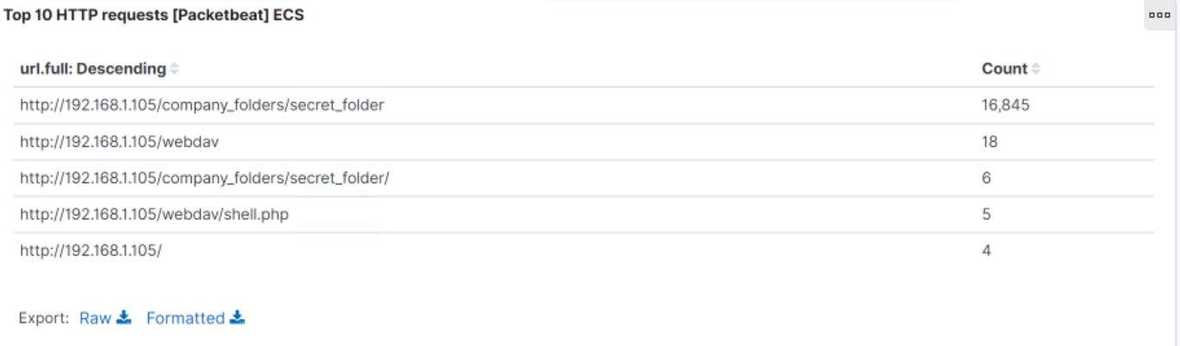
Analysis: Finding the Request for the Hidden Directory
Which files were requested? What did they contain?
The top three requests made:
http://192.168.1.105/company_folders/secret_folder
http://192.168.1.105/webdav
http://192.168.1.105/company_folders/secret_folder/

Slide 16
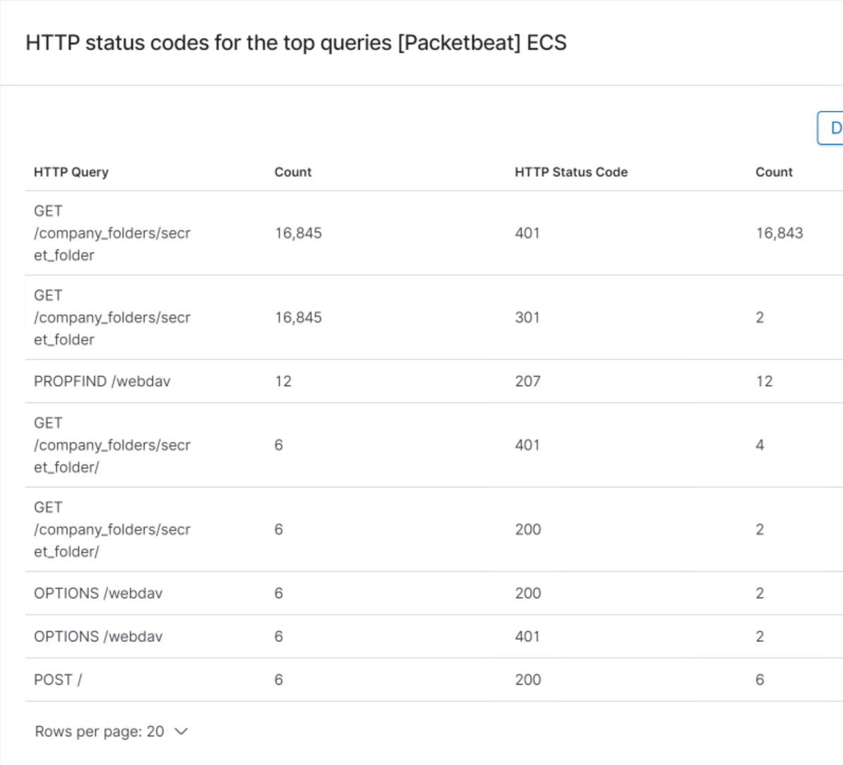

Analysis: Uncovering the Brute Force Attack
How many requests were made in the attack? 16,845
How many requests had been made before the attacker discovered the password? 16,843
The /company_folders/secret_folder/ was only accessed successfully 2 times (200 HTTP Status Code)

Slide 17
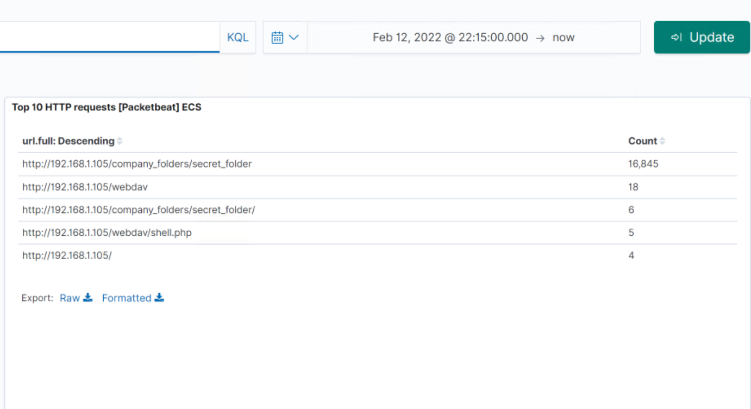
Analysis: Finding the WebDAV Connection
The protected webdav connection was also accessed
The attacker was also able to upload a shell.php file to webdav

Slide 18
Blue Team
Proposed Alarms and Mitigation Strategies
18

Slide 19
Mitigation: Blocking the Port Scan
What kind of alarm can be set to detect future port scans?
- Set an alarm for a high number of requests from an IP address per second (or a short period of time)
What threshold would you set to activate this alarm?
- Alarm is triggered when an IP address makes 20 requests per second
What configurations can be set on the host to mitigate port scans?
Limit traffic from specific IP address to reduce chances of scanning
ICMP traffic can be filtered

Slide 20
Mitigation: Finding the Request for the Hidden Directory
What kind of alarm can be set to detect future unauthorized access?
- Set an alarm if the secret folder is accessed by non approved IP addresses
What threshold would you set to activate this alarm?
- Threshold of 0
What configuration can be set on the host to block unwanted access?
Remove the secret folder from the webpage and secure the file offline
Encrypt the folder

Slide 21
Mitigation: Preventing Brute Force Attacks
What kind of alarm can be set to detect future brute force attacks?
- Set an alarm for error code 401 in a short period of time
What threshold would you set to activate this alarm?
- 8 errors within a minute
What configuration can be set on the host to block brute force attacks?
- Limit traffic from any individual IP address to reduce chances of brute force

Slide 22
Mitigation: Detecting the WebDAV Connection
What kind of alarm can be set to detect future access to this directory?
- Alert when an unknown ip address is trying to access these folders
What threshold would you set to activate this alarm?
- Set a threshold of 0. Send an alert any time it is accessed
What configuration can be set on the host to control access?
- Use Filebeat to monitor access to the directory

Slide 23
Mitigation: Identifying Reverse Shell Uploads
What kind of alarm can be set to detect future file uploads?
- Set an alert for .php or .exe files uploaded
- Set an alert for unknown ip address uploading files
What threshold would you set to activate this alarm?
- Threshold of 0. It should trigger any time a file upload occurs
What configuration can be set on the host to block file uploads?
- Limit write permission

